Slide 1



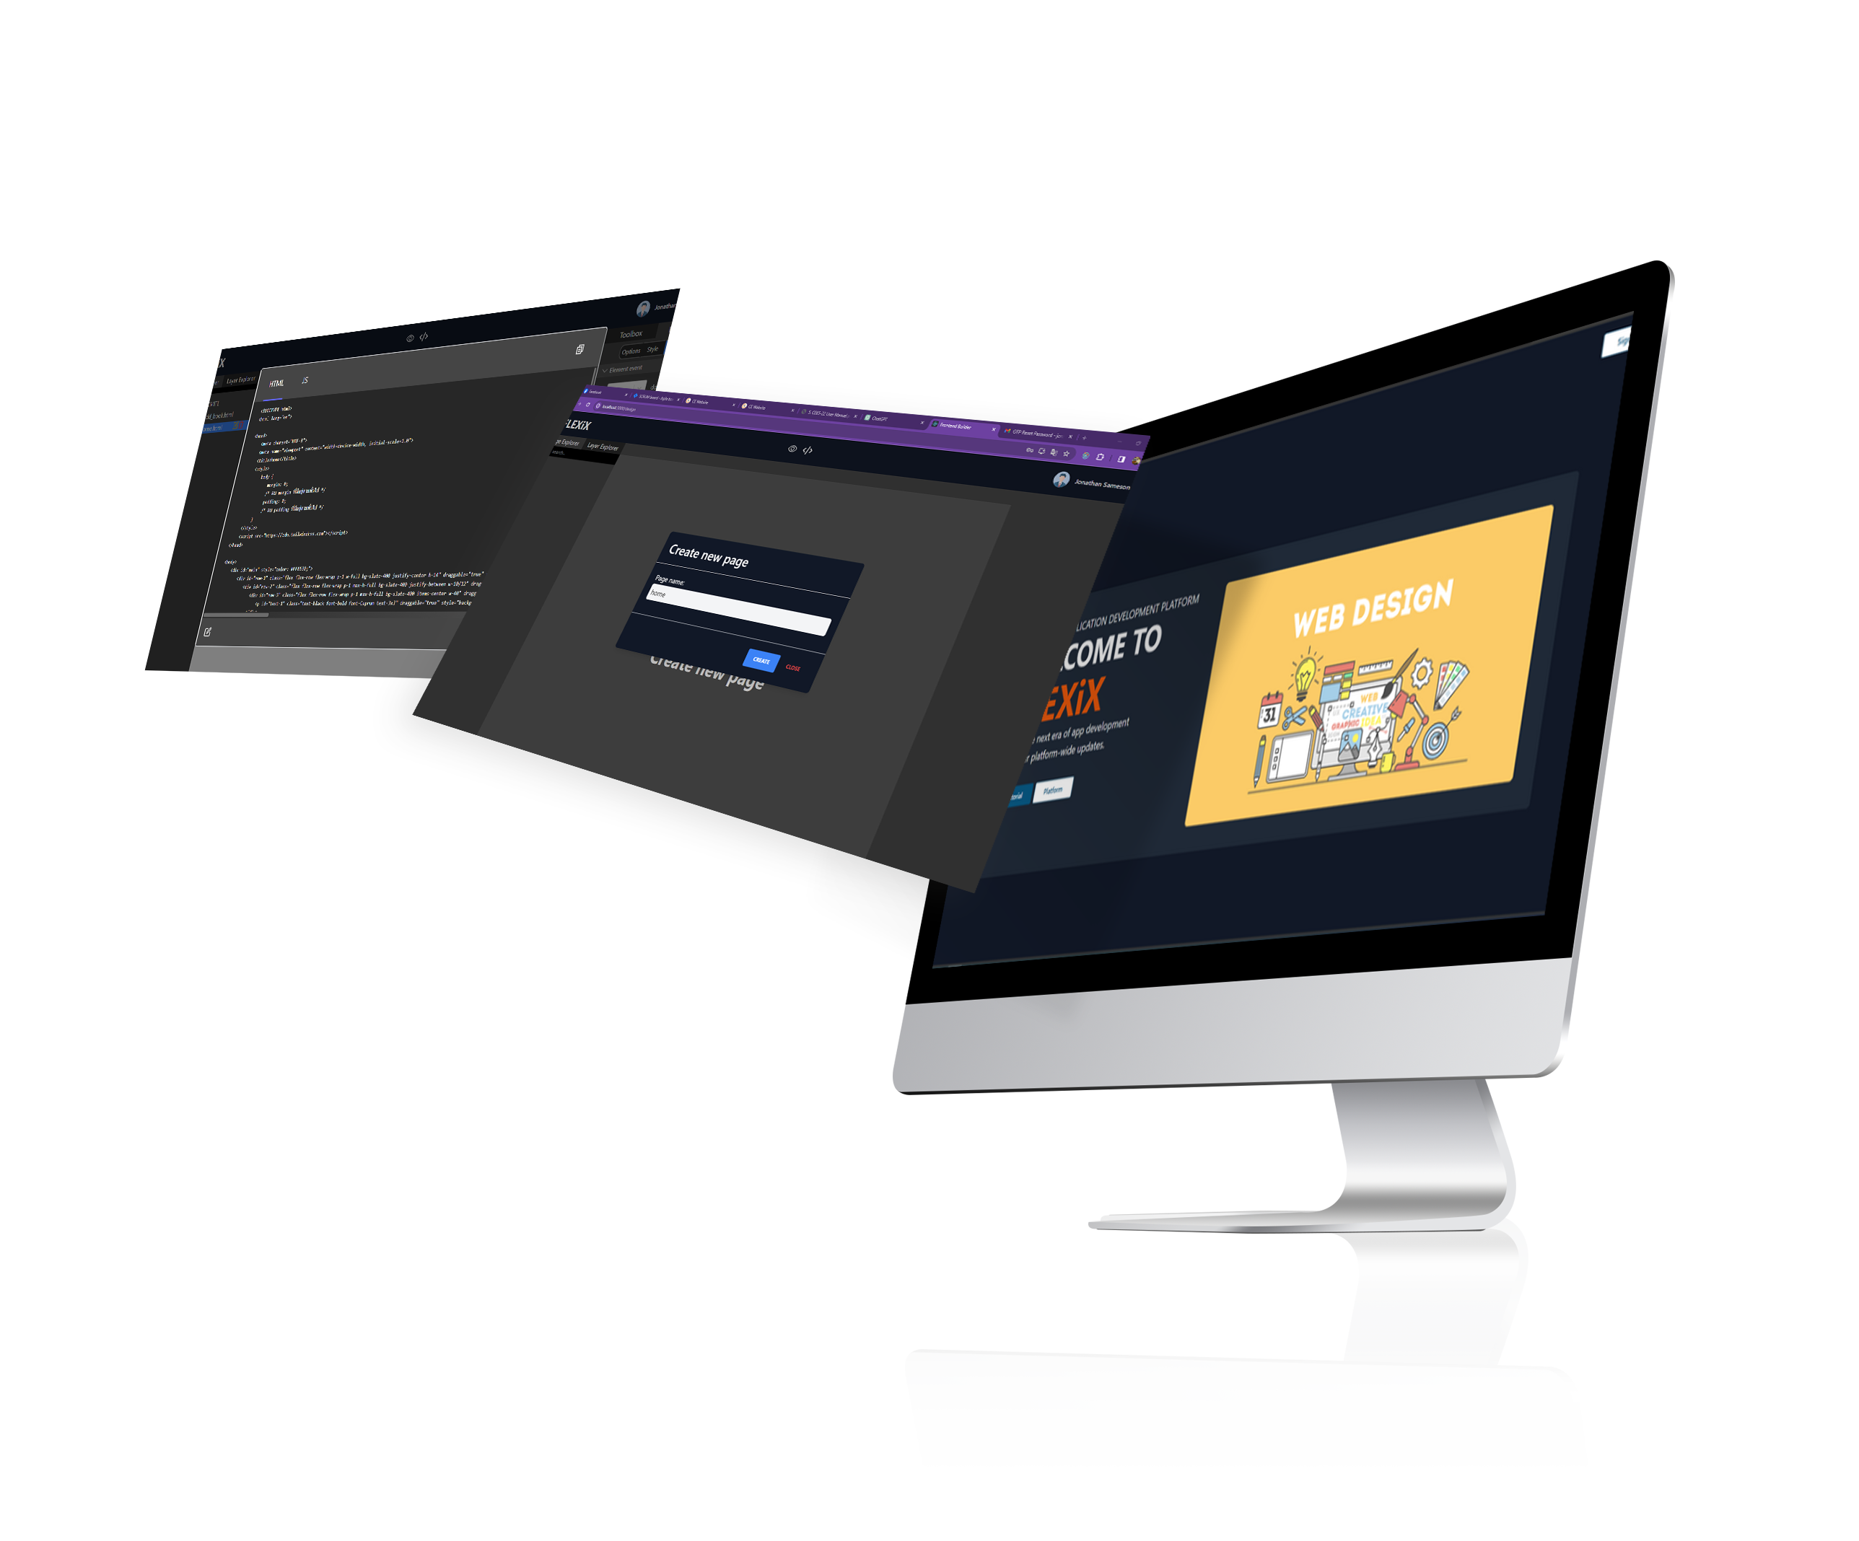



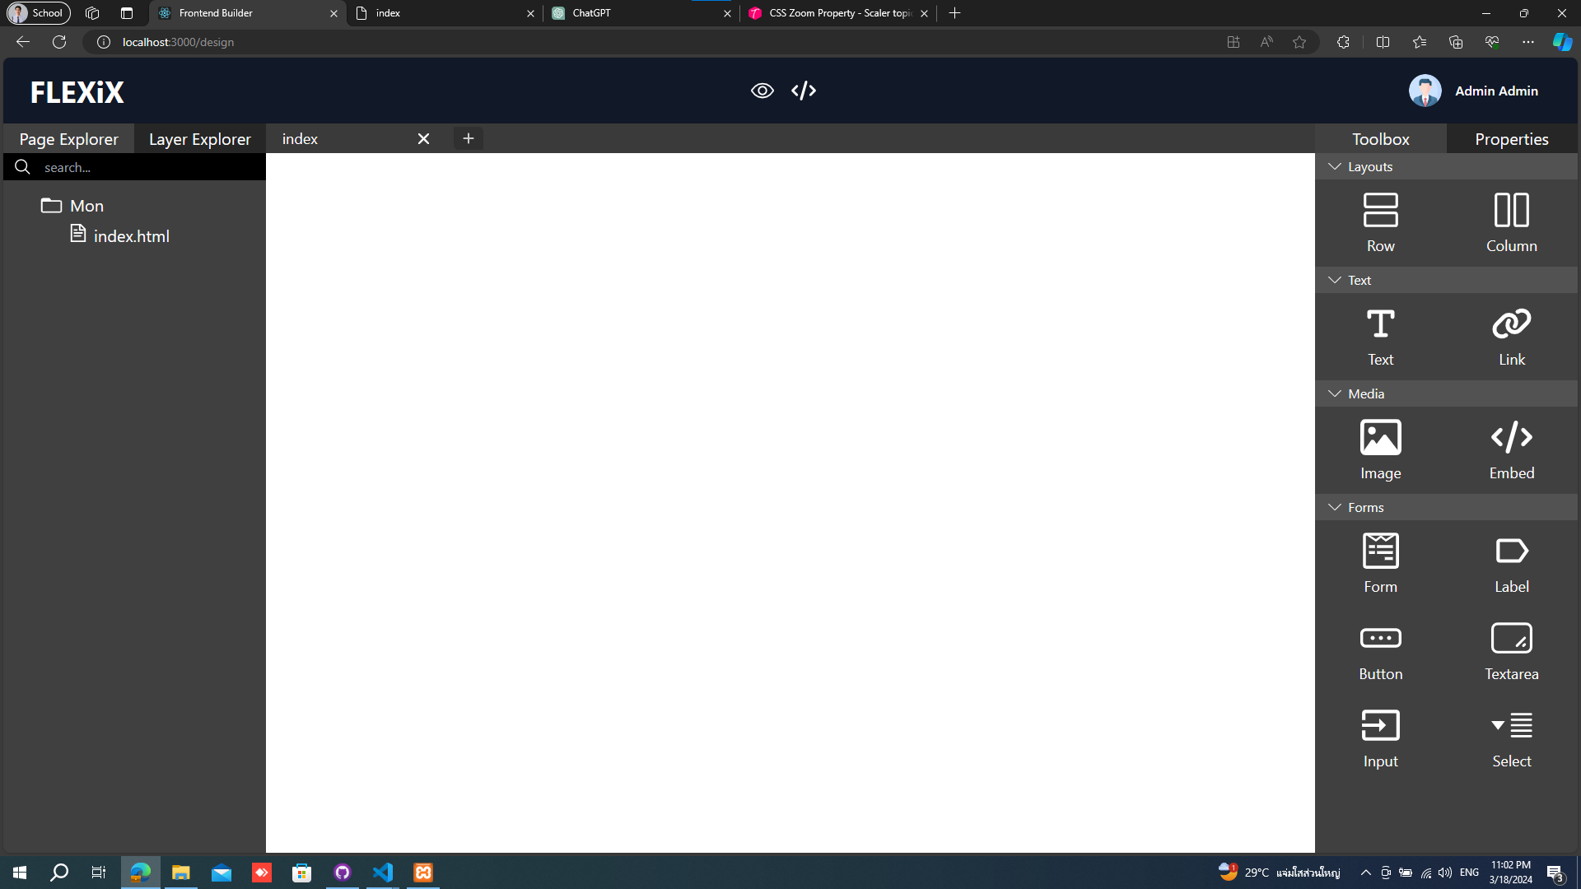




King Mongkut's Institute of Technology Ladkrabang
FLEXIX
FLEXIX
FRONTEND BUILDER
Web Frontend Builder is a user-friendly web app that lets you create frontends for websites without the need for coding. It simplifies the process and saves you time by providing drag-and-drop functionality and pre-built components. Plus, it offers seamless API integration, making it effortless to view real-time results. With Web Frontend Builder, anyone can design professional-looking web interfaces quickly and easily.
FEATURES
Create a Website
Customize CSS (Tailwind)
You can design and create your website to be visually appealing and beautiful using user-friendly tools through the UI interface
You can easily customize the style of your website using CSS templates from Tailwind.
Edit The Code
API Connection
You can edit the code yourself through the web-based editor on the website.
You can enhance your website by connecting to APIs through a user-friendly UI. Simply input the API URL you want to use and select the data mappings between your website and the API
Show Results
Export Project
You can immediately preview the results of the designed website on-screen.
You can download the source code to further develop it in the future.

